Slide 1
Data Engineering
Introduction

Slide 2
Logistics:
2 weekly hours
Assignments – 20% of the final grade
Final Exam – 80%
Weekly reception hour
or.perets@shenkar.ac.il

Slide 3
Requirements:
Programming skills in Python
Design and implementation of SQL queries
Data structures: Hash table, binary tree, analyzing complexity time
Sorting algorithms: merge-sort, quick-sort
Searching algorithms: binary search
Basic probability theory: expectation, variance, conditional probability

Slide 4
What You Are Getting
Deep knowledge of cloud architecture and data engineering methods and techniques
Basic and advanced tools for cloud computing
“From a single and local machine to the entire world”
Technical skills: improvement of programming skills, queries, analysis and computational thinking

Slide 5
What You Are Giving
Homework exercises
Class participation
Final exam
Smiles and fun ☺

Slide 6
Introduction

Slide 7

What is Cloud?
Datacenter hardware and software that the vendors use to offer the
computing resources and services.

Slide 8
What is Big Data?
Big data is a collection of large datasets that cannot be processed using traditional computing techniques. It is not a single technique or a tool.
Benefits
Using the information kept in the social network like Facebook, twitter, etc.
Using the information in the social media like preferences and product perception of their consumers.

Slide 9
Sources of Big Data
Social networking sites: Facebook, Google, LinkedIn
E-commerce site: Amazon, Flipkart, Alibaba
Weather Station: All the weather station and satellite gives very huge data which are stored and manipulated to forecast weather
Telecom company: Airtel, Vodafone
Share Market: Stock exchange across the world

Slide 10
3V's of Big Data
Velocity: The data is increasing at a very fast rate. It is estimated that the volume of data will double in every 2 years.
Variety: Data is structured as well as unstructured.
structured – predefined schema
unstructured – each document has different properties
Volume: The amount of data which we deal with is of very large size of Peta bytes.
(1 Peta = 1024 TB)

Slide 11
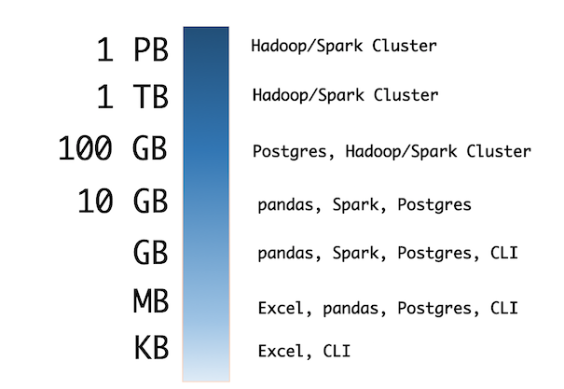
Handling Big Data
Excel
Pandas – Lecture 3
Hadoop – Lectures 4,5
Spark – Lectures 6,7
Streaming – Lectures 10,11

Slide 12
Cloud Computing
Represents both the cloud & the provided services
Why call it “cloud computing”?
Some say because the computing happens out there "in the clouds” ☺
Wikipedia: "the term derives from the fact that most technology diagrams depict the Internet or IP availability by using a drawing of a cloud."

Slide 13
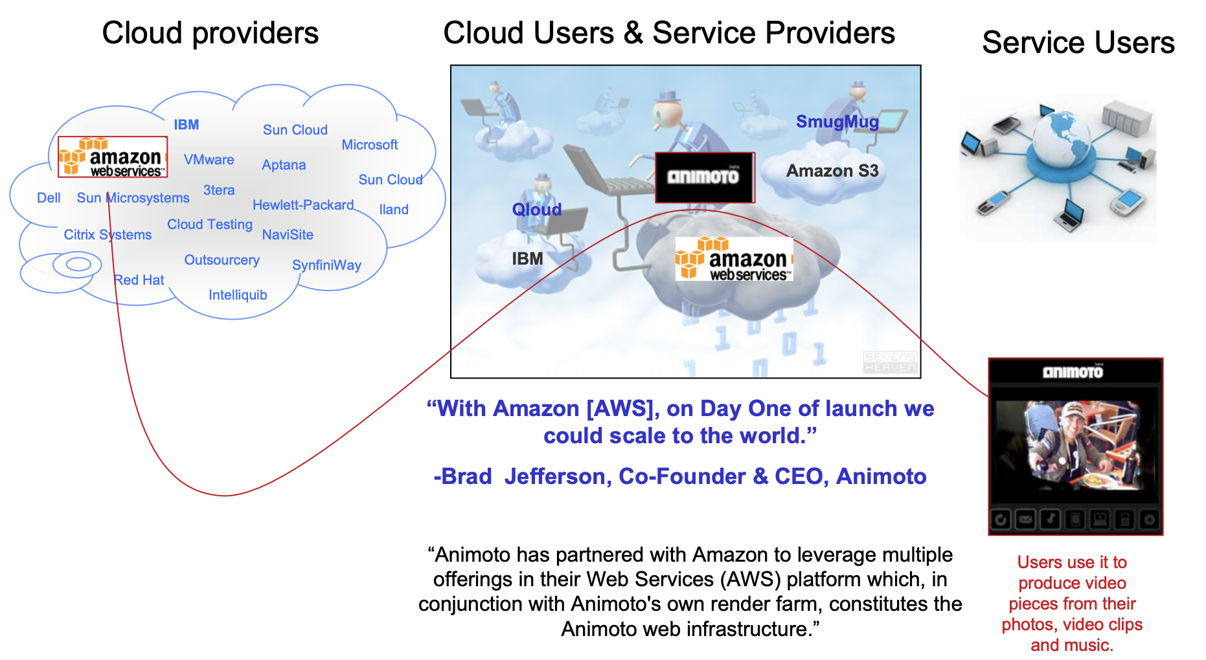
Cloud Computing

Slide 14
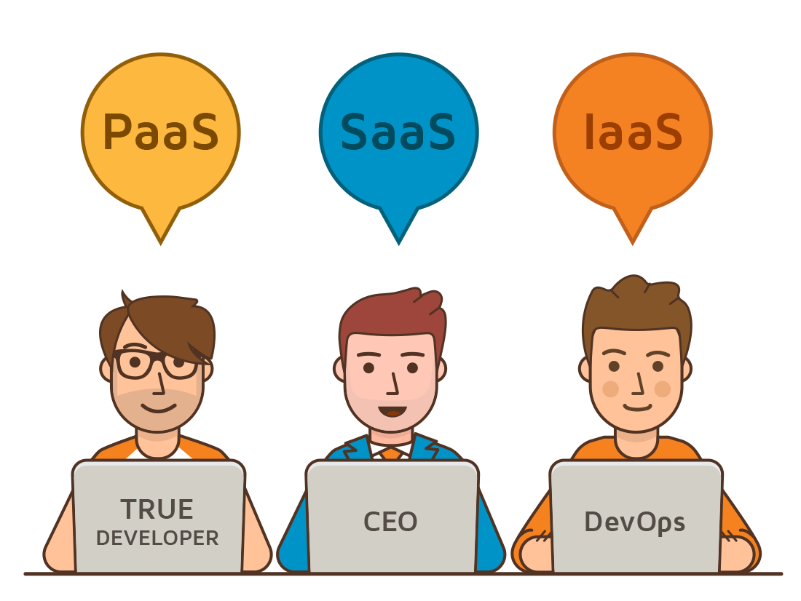
Cloud Computing Services
Software as a Service (SaaS) – applications though the browser
Platform as a Service (PaaS) - Delivery of a computing platform for custom software development as a service
Infrastructure as a Service (IaaS) - Deliver of computer infrastructure as a service
And more ..

Slide 15
Data Scientist vs. Data Engineer
With an incredible 2.5 quintillion bytes of data generated daily,
data scientists are busier than ever:
Provides methods to make use of this data
getting data for analysis to produce meaningful and useful insights
Data Science Moto: “The more information we have, the more we can do with it”

Slide 16
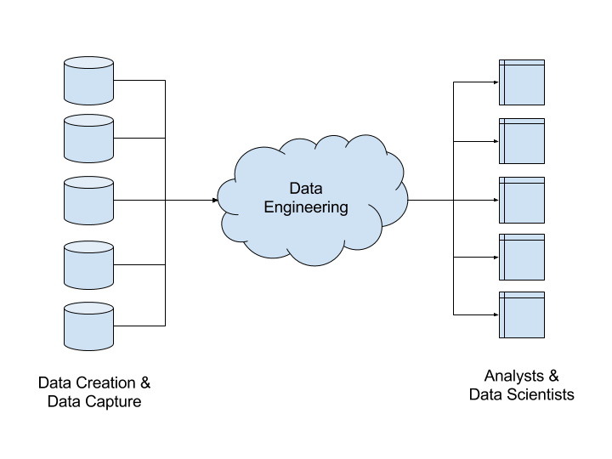
Data Scientist vs. Data Engineer
A data engineer is an engineering role within a data science team or any data related project that requires creating and managing technological infrastructure of a data platform.

Slide 17
Data Engineer Responsibilities
- Architecture design
data engineering entails designing the architecture of a data platform.
- Development of data related instances
customize and manage integration tools, databases, warehouses, and analytical systems.
- Data pipeline maintenance/testing
test the reliability and performance of each part of a system (or they can cooperate with the testing team).

Slide 18
Data Engineer Responsibilities
- Machine learning algorithm deployment
Machine learning models are designed by data scientists, data engineers are responsible for deploying those into production environments.
- Manage data and meta-data
A data engineer is managing the data stored and structuring it properly via database management systems (DBMS).
- Track pipeline stability
Monitoring the overall performance and stability of the system

Slide 19
Cloud Approaches
Deterministic
- Analysis of the entire database
- Advanced techniques for minimize the complexity time (lectures 2-9)
Stochastic
Streaming data analysis, sampling and estimations (lectures 10-12)

Slide 20
Recap – Algorithms

Slide 21

Algorithm
Definition: A finite set of statements that guarantees a solution in finite interval of time.
For example, instructions for coffee:
Take a glass
Add coffee
Add hot-water
Add sugar, if you want
Enjoy ☺

Slide 22
Algorithm
Definition: A finite set of statements that guarantees a solution in finite interval of time.
Out goal is to find algorithm / solution to a given problem that guarantees an optimal solution (not just simple solution).
What is a “good” algorithm?
Run in less time
Consume less memory

Slide 23
Running Time of an Algorithm
Depends upon - input size, nature of input
Generally, time grows with size of input, so running time of an algorithm is usually measured as function of input size.
Running time is measured in terms of number of steps/primitive operations performed
Independent from machine, OS

Slide 24
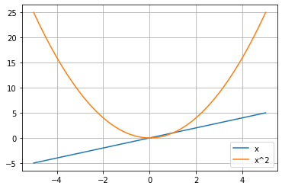
Asymptotic Notation
Most of the times, we do not need the exact number of operations. We can express the number of operations by:
$O$ – upper bound
$θ$ – tight bound
$Ω$ – lower bound
For example, $f\left(x\right)=x and g\left(x\right)=x^{2}$, so $g\left(x\right)$ is the upper bound of $f(x)$

Slide 25
Comparing Complexity Functions
f(n) | Classification
1 | Constant: run time is fixed, and does not depend upon n.
log n | Logarithmic: when n increases, so does run time, but much slower.
n | Linear: run time varies directly with n.
n log n | When n doubles, run time slightly more than doubles.
n² | Quadratic: when n doubles, runtime increases fourfold.
n³ | Cubic: when n doubles, runtime increases eightfold.
2^{n} | Exponential: when n doubles, run time squares.

Slide 26
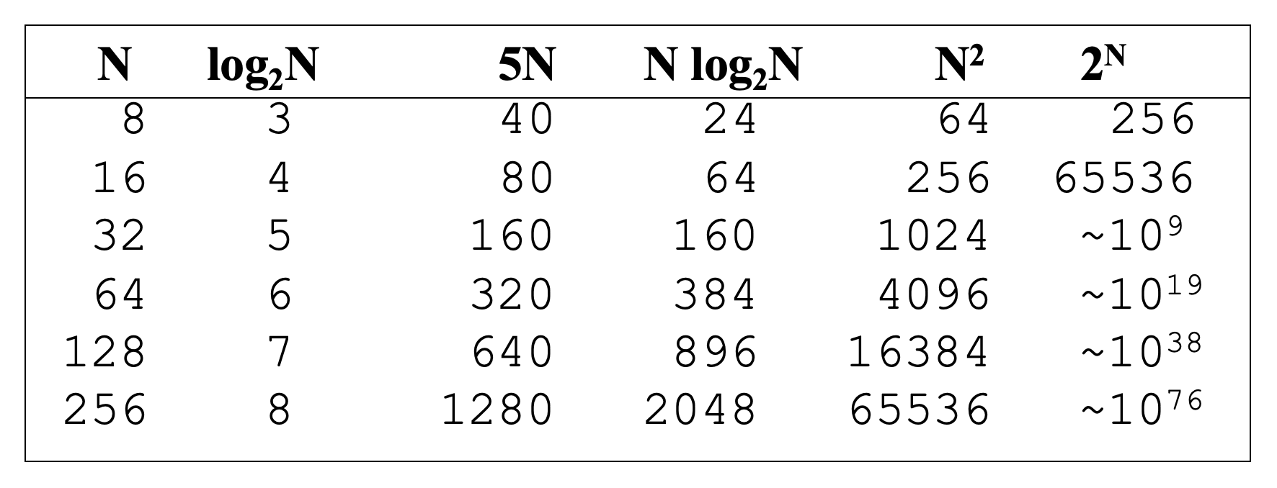
Comparing Complexity Functions

Slide 27
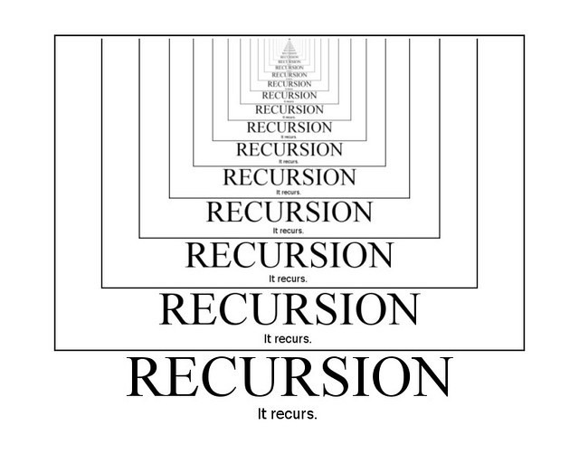
Recursion
Sometimes, the best way to solve a problem is by solving a smaller version of the exact same problem first.
Recursion is such a technique that solves a problem by solving a smaller problems of the same type.

Slide 28
Recursion
For example, the factorial problem.
$$n!=1⋅2⋅3⋅⋅⋅n$$
One way, we can implement it using loops.
Other way, we can use the recursive method:
$$4!=4⋅3! \\ 3!=3⋅2! \\ 2!=2⋅1! \\ 1!=1⋅0!$$
When to stop?

Slide 29
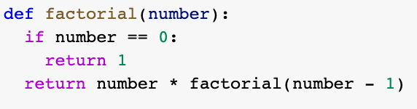
Recursion
Stop condition – what is the smallest case we know?
Recursive step – how to divide the problem?

Slide 30
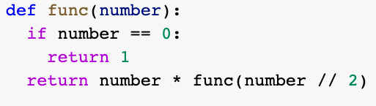
Complexity Time of Recursive Algorithms
Let $T(n)$ the recurrence equation of this algorithm.
Each iteration, the algorithm performed $O(1)$ operations (if) and call to the same problem with $T\left(\frac{n}{2}\right)$, total:
$$T\left(n\right)=T\left(\frac{n}{2}\right)+O(1)$$

Slide 31
How To Solve?
- If the recursion has division difference $\left(\frac{n}{b}\right)$: Master theorem
Let $T\left(n\right)=a⋅T\left(\frac{n}{b}\right)+n^{k}$ be a recurrence relation, then:
$$a>b^{k}$$ | $$T\left(n\right)=Θ\left(n^{\log_{b}{a}}\right)$$
$$a=b^{k}$$ | $$T\left(n\right)=Θ\left(n^{k}⋅logn\right)$$
$$a<b^{k}$$ | $$T\left(n\right)=Θ\left(n^{k}\right)$$

Slide 32
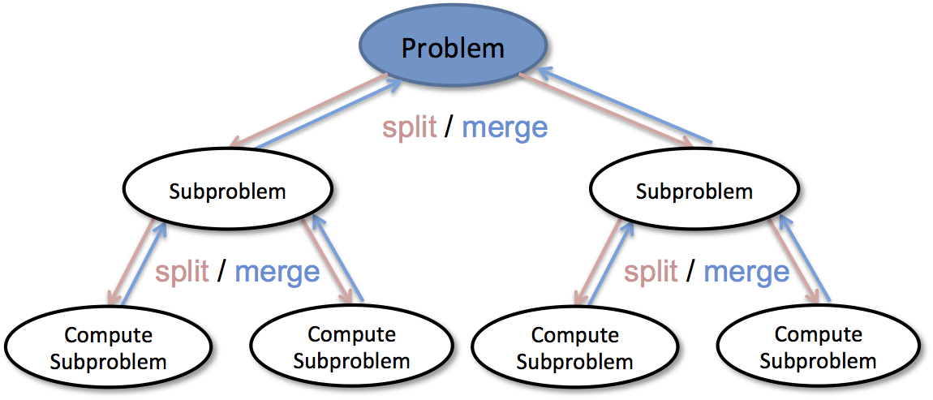
Divide and Conquer
A method of designing algorithms that (informally) proceeds as follows:
Split the problem into several, sub-instances of the same problem.
Independently solve each of the sub-instances and then combine the sub-instance solutions to yield a solution for the original instance.

Slide 33
Divide and Conquer
Divide the problem into a number of sub-problems (similar to the original problem
but smaller)
Conquer the sub-problems by solving them recursively (if a sub-problem is small enough, just solve it in a straightforward manner).
Combine the solutions for the sub-problems into a solution for the original problem

Slide 34
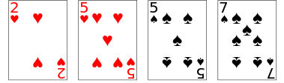
The Sorting Problem

Slide 35
The Sorting Problem
Arrangement of values from small to large or large to small.
For a list of numbers, sorting in ascending order is sorting from smallest to largest.
For a list of letters, sorting in descending order is sorting from the last letter to the first letter.
For a list of words, we will sort them lexicographically (according to the dictionary).

Slide 36
Merge Sort – Divide and Conquer
Merge Sort is a Divide and Conquer algorithm. It divides the input array into two halves, calls itself for the two halves, and then merges the two sorted halves.
Process: divide it in two at the midpoint, conquer each side in turn (by recursively sorting), merge two halves together.
8
2
9
4
5
3
1
6

Slide 37
Merge Sort – Divide and Conquer
8
2
9
4
5
3
1
6
Divide
8 2 9 4
5 3 1 6
Divide
8 2
9 4
5 3
1 6
Divide
1 element
8 2 9 4 5 3 1 6
Merge
2 8 4 9 3 5 1 6
Merge
2 4 8 9 1 3 5 6
Merge
1 2 3 4 5 6 8 9

Slide 38
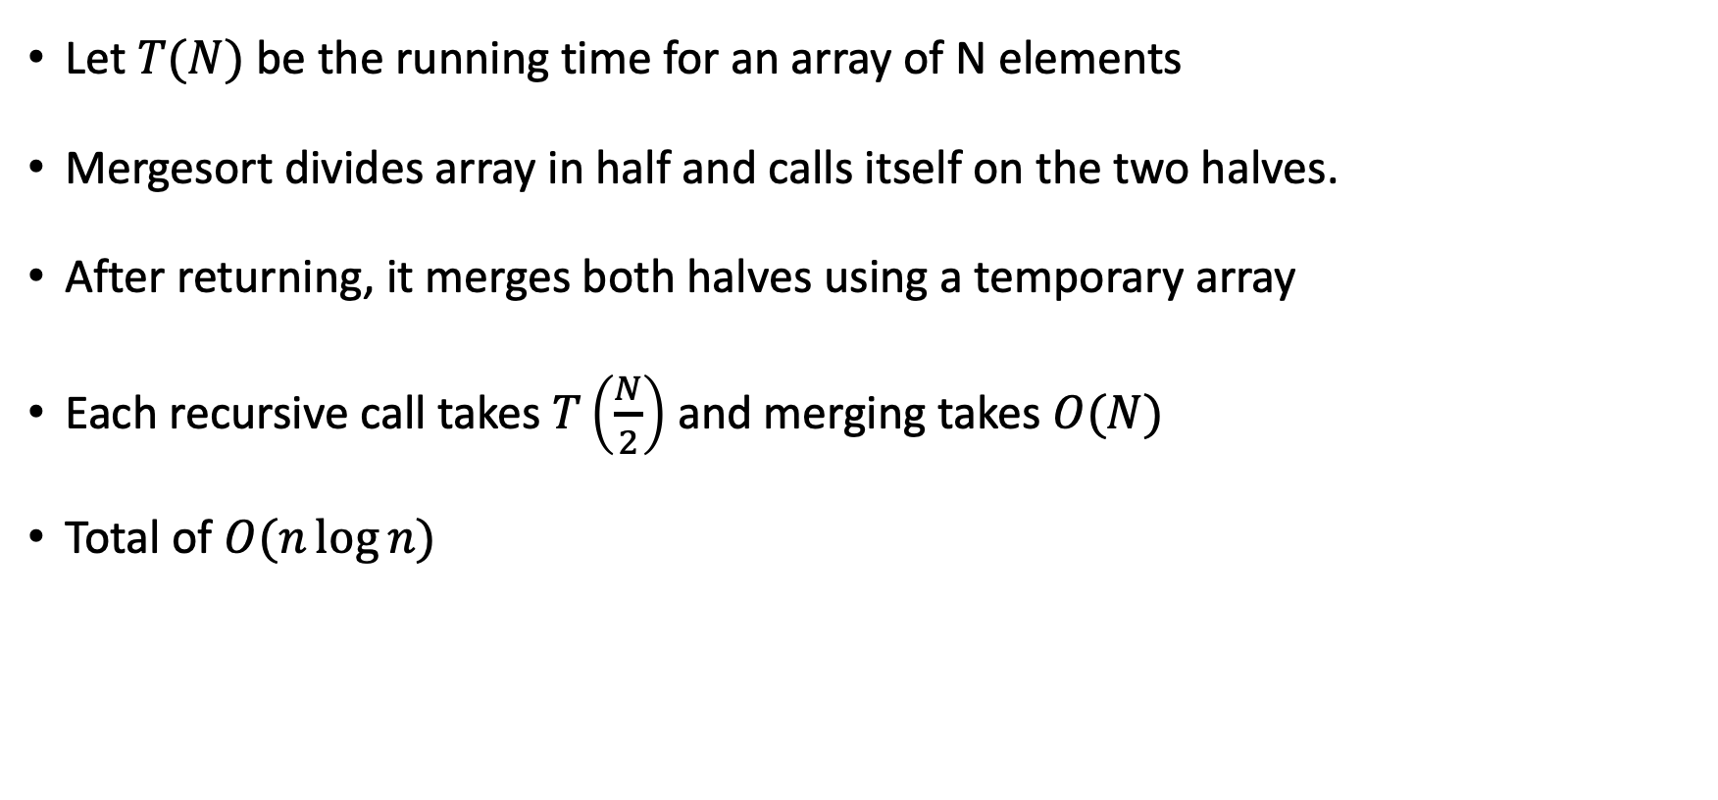
Merge-sort Analysis
Let $T(N)$ be the running time for an array of N elements
Mergesort divides array in half and calls itself on the two halves.
After returning, it merges both halves using a temporary array
Each recursive call takes $T\left(\frac{N}{2}\right)$ and merging takes $O(N)$
Total of $O(n\log{n})$

Slide 39
Quicksort
Quicksort uses a divide and conquer strategy:
Partition array into left and right sub-arrays
Choose an element of the array, called pivot
the elements in left sub-array are all less than pivot
elements in right sub-array are all greater than pivot
Recursively sort left and right sub-arrays
Concatenate left and right sub-arrays in O(1) time

Slide 40
The steps of QuickSort
S
select pivot value
81
43
31
57
13
75
92
0
65
26
S₁
S₂
partition S
0
31
75
13
43
65
92
81
26
57
QuickSort(S1) and
QuickSort(S2)
S₁
S₂
0
13
26
31
43
57
65
75
81
92
S
S is sorted
0
13
26
31
43
57
65
75
81
92

Slide 41
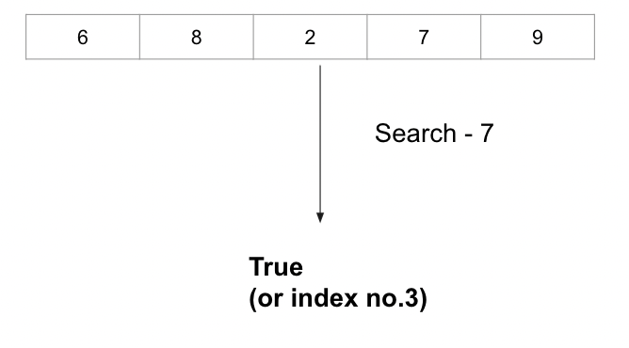
Searching
Searching is the process of looking for a particular value in a collection.
For example, a program that maintains a membership list for a club might need to look up information for a particular member – this involves some sort of search process.

Slide 42
Binary Search
Perhaps we can do better than O(n) in the average case?
Assume that we are give an array of records that is sorted. For instance:
an array of records with integer keys sorted from smallest to largest (e.g., ID numbers), or
an array of records with string keys sorted in alphabetical order (e.g., names).

Slide 43
Binary Search
Example: sorted array of integer keys. Target=7.
[ 0 ]
[ 1 ]
[ 2 ]
[ 3 ]
[ 4 ]
[ 5 ]
[ 6 ]
3
6
7
11
32
33
53

Slide 44
Binary Search
Example: sorted array of integer keys. Target=7.
[ 0 ]
[ 1 ]
[ 2 ]
[ 3 ]
[ 4 ]
[ 5 ]
[ 6 ]
3
6
7
11
32
33
53
Find approximate midpoint

Slide 45
Binary Search
Example: sorted array of integer keys. Target=7.
[ 0 ]
[ 1 ]
[ 2 ]
[ 3 ]
[ 4 ]
[ 5 ]
[ 6 ]
3
6
7
11
32
33
53
Is 7 = midpoint key? NO.

Slide 46
Binary Search
Example: sorted array of integer keys. Target=7.
[ 0 ]
[ 1 ]
[ 2 ]
[ 3 ]
[ 4 ]
[ 5 ]
[ 6 ]
3
6
7
11
32
33
53
Is 7 < midpoint key? YES.

Slide 47
Binary Search
Example: sorted array of integer keys. Target=7.
[ 0 ]
[ 1 ]
[ 2 ]
[ 3 ]
[ 4 ]
[ 5 ]
[ 6 ]
3
6
7
11
32
33
53
Search for the target in the area before midpoint.

Slide 48
Binary Search
Example: sorted array of integer keys. Target=7.
[ 0 ]
[ 1 ]
[ 2 ]
[ 3 ]
[ 4 ]
[ 5 ]
[ 6 ]
3
6
7
11
32
33
53
Find approximate midpoint

Slide 49
Binary Search
Example: sorted array of integer keys. Target=7.
[ 0 ]
[ 1 ]
[ 2 ]
[ 3 ]
[ 4 ]
[ 5 ]
[ 6 ]
3
6
7
11
32
33
53
Target = key of midpoint? NO.

Slide 50
Binary Search
Example: sorted array of integer keys. Target=7.
[ 0 ]
[ 1 ]
[ 2 ]
[ 3 ]
[ 4 ]
[ 5 ]
[ 6 ]
3
6
7
11
32
33
53
Target < key of midpoint? NO.

Slide 51
Binary Search
Example: sorted array of integer keys. Target=7.
[ 0 ]
[ 1 ]
[ 2 ]
[ 3 ]
[ 4 ]
[ 5 ]
[ 6 ]
3
6
7
11
32
33
53
Target > key of midpoint? YES.

Slide 52
Binary Search
Example: sorted array of integer keys. Target=7.
[ 0 ]
[ 1 ]
[ 2 ]
[ 3 ]
[ 4 ]
[ 5 ]
[ 6 ]
3
6
7
11
32
33
53
Search for the target in the area after midpoint.

Slide 53
Binary Search
Example: sorted array of integer keys. Target=7.
[ 0 ]
[ 1 ]
[ 2 ]
[ 3 ]
[ 4 ]
[ 5 ]
[ 6 ]
3
6
7
11
32
33
53
Find approximate midpoint.
Is target = midpoint key? YES.

Slide 54
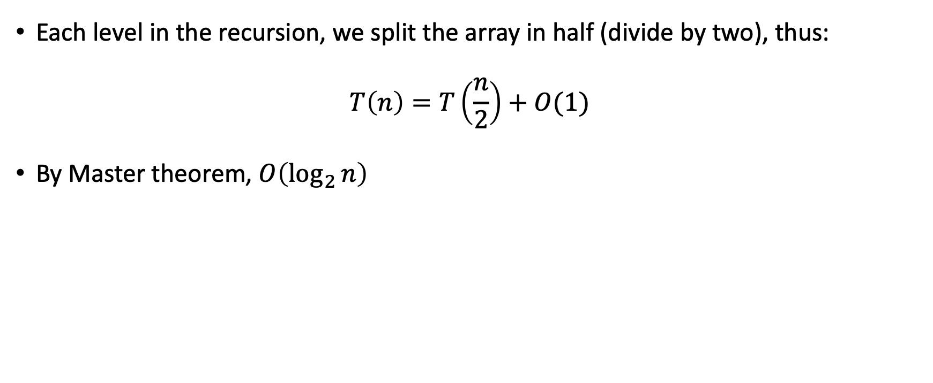
Binary Search: Analysis
Each level in the recursion, we split the array in half (divide by two), thus:
$$T\left(n\right)=T\left(\frac{n}{2}\right)+O(1)$$
By Master theorem, $O\left(\log_{2}{n}\right)$

Slide 55
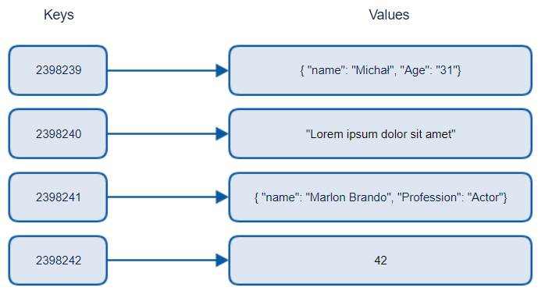
Hash Tables
Provides virtually direct access to objects based on a key (a unique String or Integer).
Must have unique keys

Slide 56

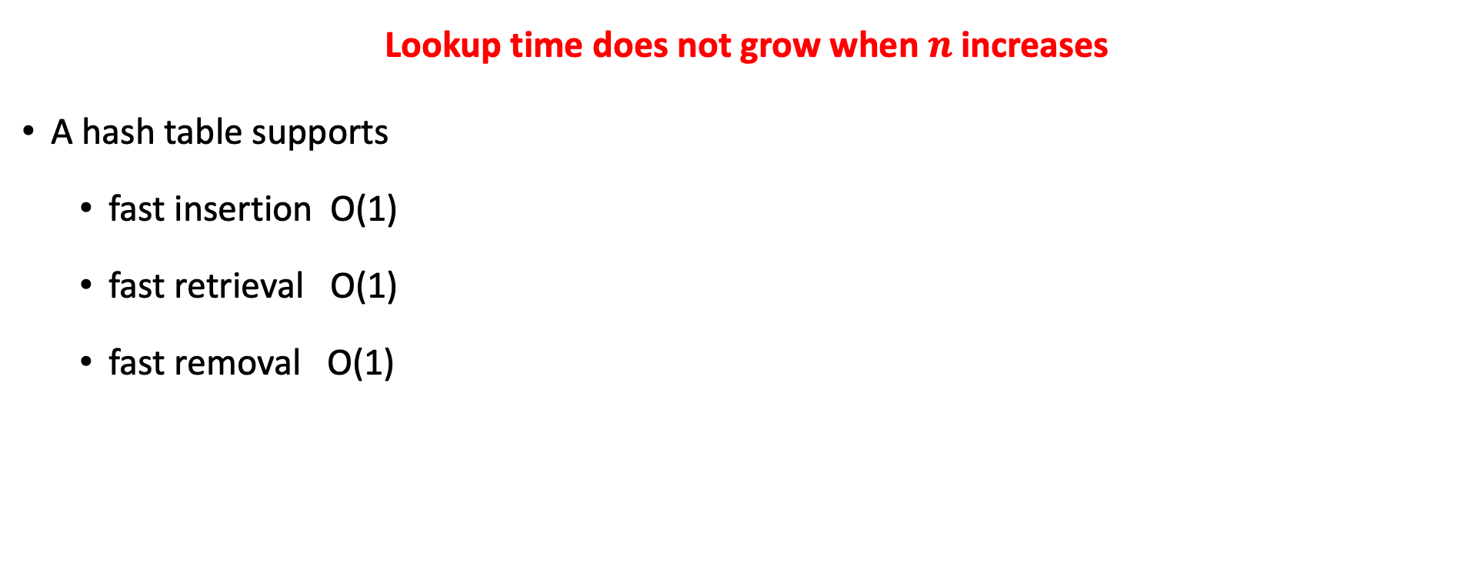
Hash Tables: Runtime Efficient
Lookup time does not grow when $n$ increases
A hash table supports
fast insertion O(1)
fast retrieval O(1)
fast removal O(1)

Slide 57
Recap – Probability

Slide 58
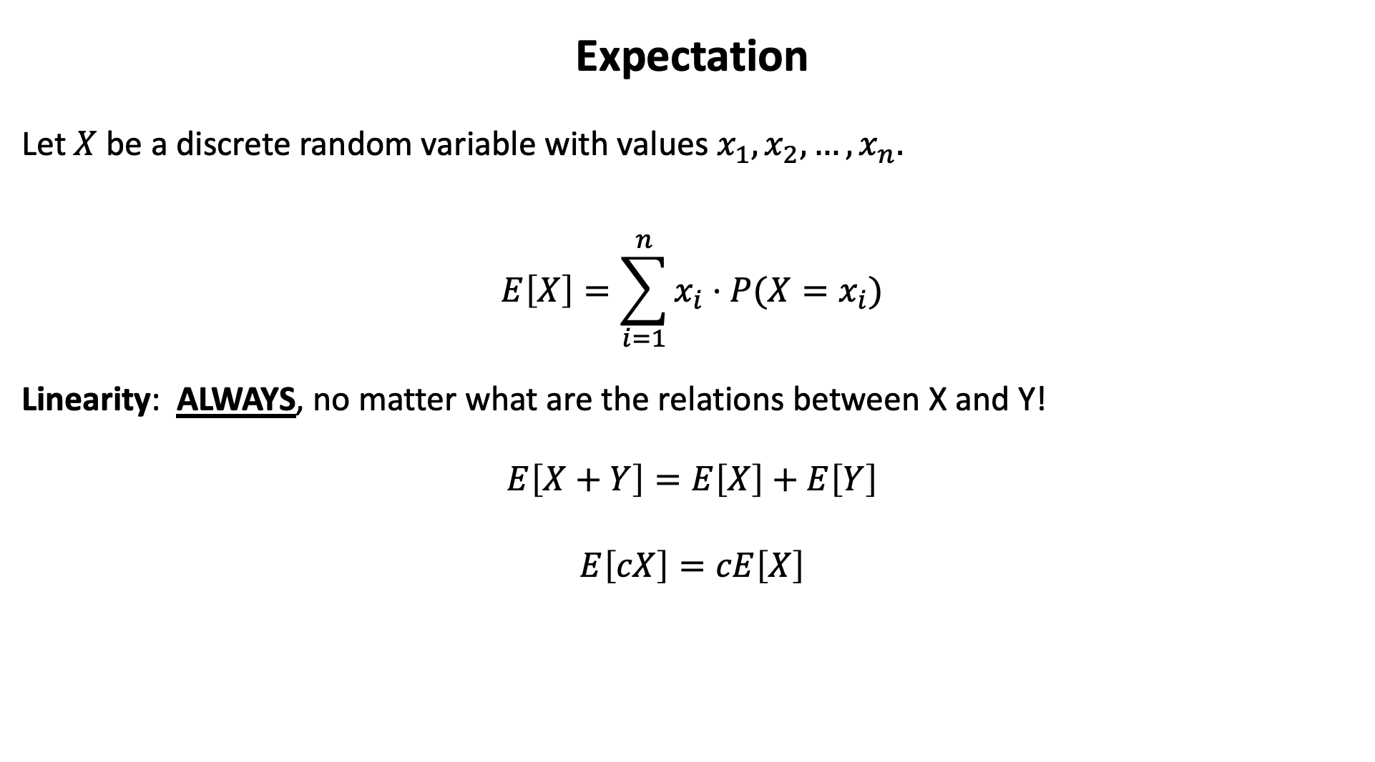
Expectation
Let $X$ be a discrete random variable with values $x_{1},x_{2},…, x_{n}.$
$$E\left[X\right]=\sum_{i=1}^{n}{x_{i}⋅P(X=x_{i})}$$
Linearity: ALWAYS, no matter what are the relations between X and Y!
$$E\left[X+Y\right]=E\left[X\right]+E\left[Y\right]$$
$$E\left[cX\right]=cE\left[X\right]$$

Slide 59
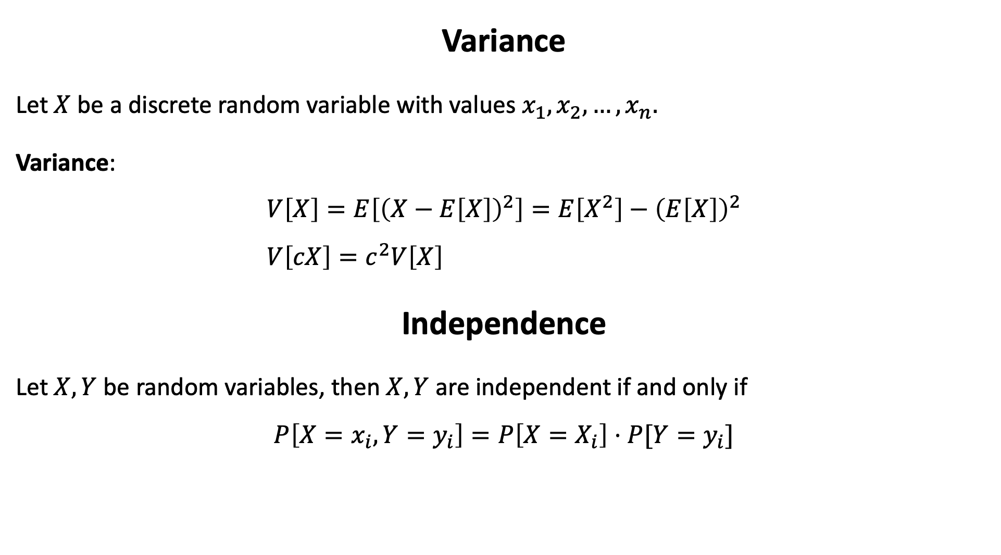
Variance
Let $X$ be a discrete random variable with values $x_{1},x_{2},…, x_{n}.$
Variance:
$$V\left[X\right]=E\left[{\left(X−E\left[X\right]\right)}^{2}\right]=E\left[X^{2}\right]−{\left(E\left[X\right]\right)}^{2} \\ V\left[cX\right]=c^{2}V\left[X\right]$$
Independence
Let $X,Y$ be random variables, then $X,Y$ are independent if and only if
$$P\left[X=x_{i},Y=y_{i}\right]=P\left[X=X_{i}\right]⋅P[Y=y_{i}]$$

Slide 60
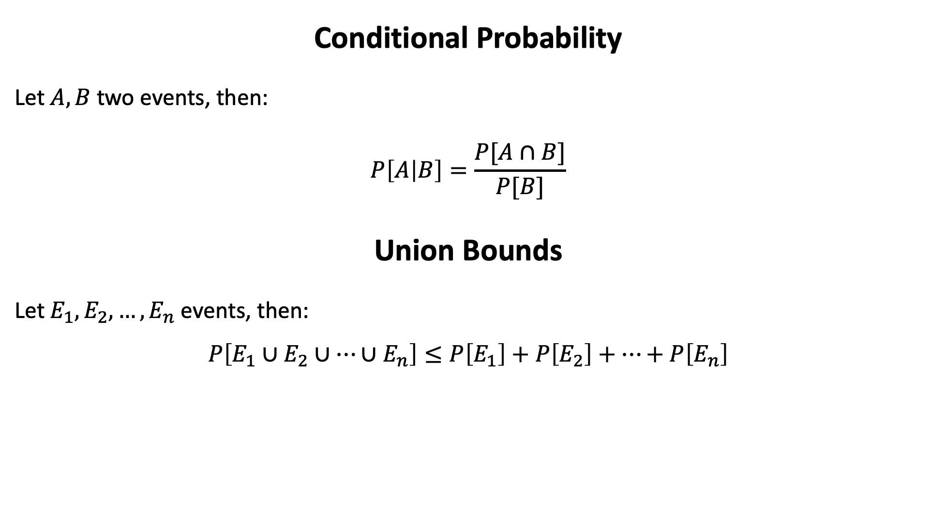
Conditional Probability
Let $A,B$ two events, then:
$$P\left[A | B\right]=\frac{P[A∩B]}{P[B]}$$
Union Bounds
Let $E_{1},E_{2},…, E_{n}$ events, then:
$$P\left[E_{1}∪E_{2}∪…∪E_{n}\right]≤P\left[E_{1}\right]+P\left[E_{2}\right]+…+P\left[E_{n}\right]$$

